Slide 1

CMake Training Session 2 More Advanced CMake
Jamie Smith

Slide 2
Intro: A Short History of CMake
2000: Kitware contracted to develop a new build system for a bioinformatics program called ITK: a Cross-platform Make
2006: Massive KDE project (Linux desktop environment) switches its entire build system to CMake and gives it rave reviews.
2014: CMake 3.0 is released, introducing many of the features we use as standard today.
More good info: https://www.aosabook.org/en/cmake.html
Notes:
2000: Kitware contracted to develop a new build system for a bioinformatics program called ITK: a Cross-platform Make
Had to be able to read in a buildscript in a single format and generate Makefiles for Linux and Visual Studio project files for Windows
Needed to support complex configurations, 3rd party libraries, and custom commands which generate source files
The CMake of the early 00s was very different from what we know today. It used an almost completely different set of commands, most of which operated at the global scope
2006: Massive KDE project (Linux desktop environment) switches its entire build system to CMake and gives it rave reviews. Many other open-source projects begin to follow suit over the next few years.
2014: CMake 3.0 is released, introducing many of the features we use as standard today.
More good info: https://www.aosabook.org/en/cmake.html

Slide 3
Part 1
Targets and Properties

Slide 4
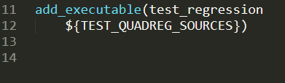
What is a target?
A target is anything that CMake can build:
Executable
Static library
Shared library
Object library
Custom target (we’ll talk about these in session 4)
The entire purpose of a build system, its reason for existence, is to create targets.

Slide 5
CMake build systems are structured around targets
All code files are compiled as part of one target or another
Dependencies are expressed in terms of targets
“Dependency” in CMake means “build X before Y”
Dependencies are automatically created between an executable and its libraries
myprogram
libmylibrary.a

Slide 6
Executable targets
Created by add_executable()
Create programs that can be run (.exe on Windows, no suffix on Mac)
On microcontrollers, e.g. MBed, these create images that can be programmed to the chip

Slide 7
Static library targets
Created by add_library(STATIC)
Create static libraries of code that can be linked into executables (.lib on Windows MSVC, .a elsewhere)

Slide 8
Object library targets
Created by add_library(OBJECT)
Create object libraries: code compiled into .o files but not combined into a single library
Function very similar to STATIC libraries, used in certain specific cases
Most common use: improving performance by only building certain code files once that are needed for multiple targets
You likely won’t need to use these except for very complicated build systems!

Slide 9
Properties can be used to configure the build further
What you can’t accomplish through functions in CMake, you accomplish through properties.
Properties determine the specific details of how CMake builds a target, such as compile flags and link libraries
Properties can be set on a number of different levels:
Global (affects the entire project)
Directory (affects the current directory and all subdirectories)
Target (affects a specific target)
Source (affects a specific source file in all targets it’s present in)

Slide 10
Properties for code compliation
Property | Scope | Function
INCLUDE_DIRECTORIES | Directory, Target, Source (since CMake 3.11) | List of directories to add to the include path
COMPILE_DEFINITIONS | Directory, Target, Source | List of preprocessor macros to define when compiling the code
COMPILE_OPTIONS | Directory, Target, Source (since CMake 3.11) | List of compiler flags to use when compiling the code.
POSITION_INDEPENDENT_CODE | Target | Controls whether the code will be built as position independent, which is required when compiling shared libraries.

Slide 11
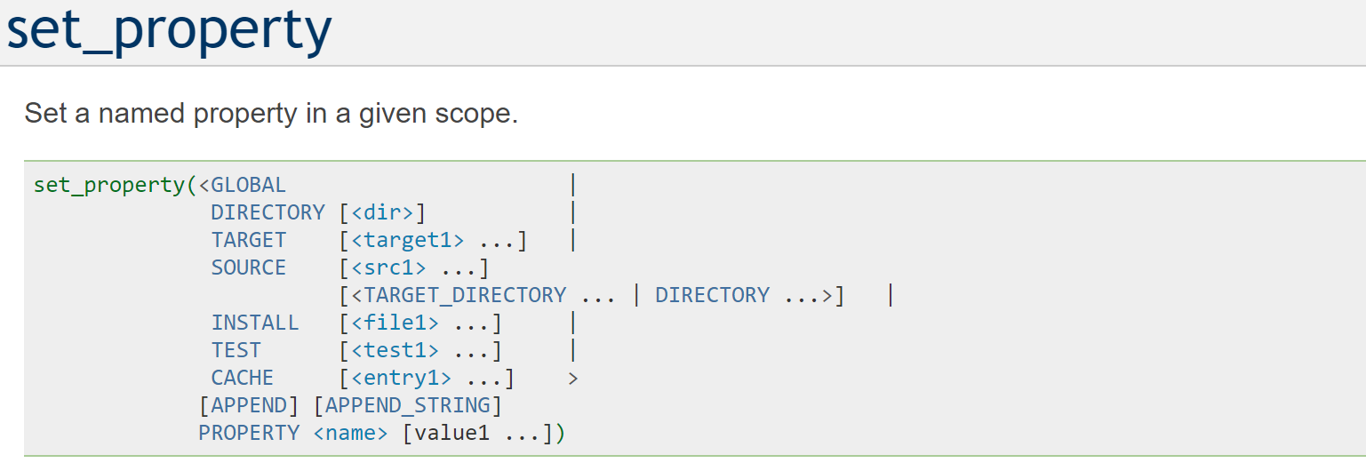
Setting properties the standard way
CMake has a number of different functions to set properties, but some of them have hidden gotchas!
e.g. not accepting a list as a property value
Instead, use the one function that can do it all:

Slide 12
Setting global properties
set_property(GLOBAL)

Slide 13
Part 2
Build Types and Compile Flags

Slide 14
The Weirdness that is Cache Variables
Like all build systems, CMake provides a way for you to pass command line options that affect the build system’s behavior
It’s also desirable to have a way to store the results of different tests so the buildscript runs faster when you run it subsequent times
For CMake, both of these are achieved through the same mechanism: cache variables
Cache variables are special variables that keep their values between invocations of CMake

Slide 15
Creating Cache Variables
Cache variables are created using an alternate signature for set().
Signature: set(<variable> <value>... CACHE <type> <docstring> [FORCE])
CACHE keyword argument specifies cache signature
Type specifies the type of data that will be stored in the variable.
Possible values: BOOL, FILEPATH, PATH, STRING, INTERNAL
docstring is the comment that will be attached to the variable in the cache
If FORCE is given, the variable’s value will be overwritten. Otherwise it will not be modified if it already exists
Why is this?

Slide 16
Command Line Options
Cache variables can also be set on the command line using –DMY_CACHE_VAR=<value>
Intention is for set(CACHE) to be used to initialize an option with a default value, and then the user can override it on the command line
However, sometimes scripts need to store data even though it isn’t a settable option. This is what the INTERNAL type, which hides the variable from the user, is for

Slide 17
Viewing Cache Variables
Cache variables can be viewed and edited by:
Editing CMakeCache.txt
Using the ccmake tool
Using the cmake-gui tool
The intention was for these to provide a user-friendly interface for configuring CMake projects
However, 95% of users don’t know these exist, so developers don’t usually spend time making them clean and usable, so people rarely use them
Bit of a chicken-and-egg problem…

Slide 18
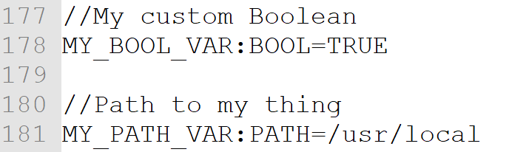
Cache Variable Example: CMakeCache.txt
<snip>

Slide 19
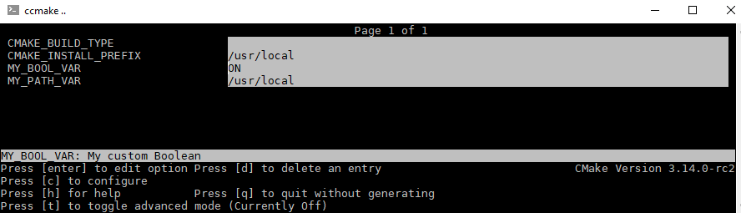
Cache Variable Example: ccmake

Slide 20
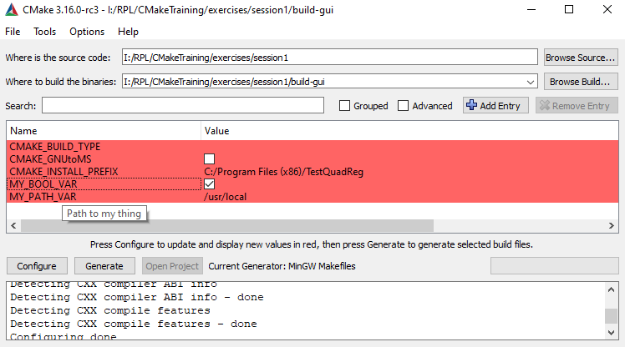
Cache Variable Example: cmake-gui

Slide 21
Cache Variable Overriding: A Cheat Sheet
This is one of the most confusing things in CMake by a large margin. Even I still mess it up.
If a _____ is defined, and you set a ____ with the same name, then…
local variable | local variable | The local variable’s value is changed.
cache variable | cache variable (without FORCE) | The cache variable’s original value is not changed
cache variable | cache variable (with FORCE) | The cache variable’s original value is overwritten
cache variable | local variable | The cache variable is shadowed while the local variable is in scope
local variable | cache variable | If the cache variable was already in the cache, then the cache variable stays out of scope. However, if the cache variable did not exist, the local variable is deleted and the new cache variable is put into scope

Slide 22
Cache Variables Practice 1
What will it print?
-- Stuff will be installed to: /usr

Slide 23
Cache Variables Practice 2
What will it print?
-- Stuff will be installed to: /opt

Slide 24
Cache Variables Practice 3
What will it print?
The first time CMake is run:
-- Stuff will be installed to: /opt
Subsequent runs:
-- Stuff will be installed to: /usr

